Slide 1
ArmyIgnitED 101 Training
NEBRANSKA ARNG Education Services Branch
G1 Education & Incentives
As of: 15 May 2025

Slide 2
Requirement
As of 1 October 2024, Soldiers must complete ArmyIgnitED 101 training and Career Path Decide (CPD) prior to creating an education goal to receive Federal Tuition Assistance (one-time completion)
Grandfather Clause: Soldiers who have used TA/CA benefits prior to 1 October 2024 are NOT required to complete this training
2
CUI

Slide 3
Purpose
Ensure knowledge of:
  Benefits of ArmyIgnitED
  Tuition and Credentialing Assistance Basics
  State Tuition Assistance
  GI Bill: CH 1606
  Testing: AFCT & SIFT
  Creating your Account
  Navigating ArmyIgnitED
  Support
  Next Steps
3
CUI

Slide 4
Benefits of ArmyIgnitED
Provides access to Federal Tuition Assistance (FTA) and Credentialing Assistance (CA) for AD, ARNG, and USAR Soldiers
Automates FTA and CA online enrollment, 24/7, eliminating wait times and reducing time away from duty
Allows online visibility of student record to view FTA balances, class grades, current course enrollments, including the ability to submit and cancel FTA/CA requests
Provides access to virtual messaging tools to connect with their Education Center
4
CUI

Slide 5
Explore What to Study
Career Path Decide https://www.careerpathdecide.org/
  Research detailed Information on specific career/vocation outlooks
  Provides information on institutions that are eligible for TA
  Take skill assessments to view school options
Kuder Journey https://journey.kuder.com/
  Learn about interests, skills, and values with research-based assessments
  Plan education and career based off the assessments
  Use the planning tools to be successful in education/career choices
Next Step: Make an appointment with an Education Counselor to discuss your completed assessment report to determine what you will study
5
CUI

Slide 6
Joint Services Transcript (JST)
Your JST documents of all your military training and experience
American Council on Education evaluates your military training and experience and recommends college credit
Colleges and Universities may or may not accept this credit toward your degree
Any credit awarded toward your degree means less time in the classroom
Request official JST to be sent to your college
Transcript requests are free
Login at https://jst.doded.mil/
6
CUI

Slide 7
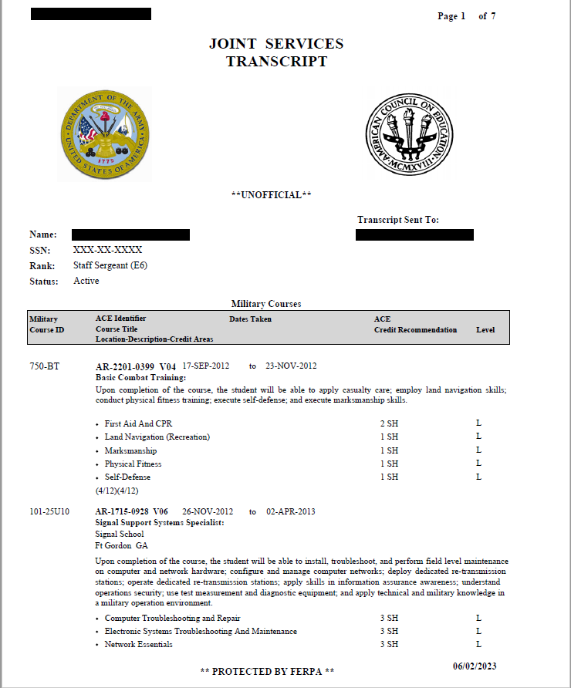
Sample JST
7
CUI

Slide 8
Tuition Assistance Basics
Fiscal Year (FY) Limits
  $4,500 per fiscal year (1 Oct-30 Sept)
  18 Semester Hour (SH)/24 Quarter Hour (QH) credits per fiscal year (FY)
  Up to $250 per SH or $165 per QH
  Funds do not roll over to next FY
  Lifetime SH limits:
    Undergraduate - 130
    Graduate - 39
    Academic Certificate - 21
    Special Programs - 39
8
CUI

Slide 9
Tuition Assistance Basics (continued)
Course Grades
  Soldiers must pass their courses or they will be recouped
  Passing for undergraduate courses is a C- or higher
  Passing for graduate courses is a B- or higher
GPA Requirements
  2.0 Undergraduate GPA after 15 SH
  3.0 Graduate GPA after 6 SH
  No Recoupment Waivers for failing grades unless a “W”
  Waiver must be within 30 days of the “W” grade posted by the school
9
CUI

Slide 10
Federal Tuition Assistance Basics
Enrollment Timelines
  Must apply for FTA no more than 60 calendar days and no later than 8 days prior to term start date
  Requests between 7 days prior and the start date of classes will be denied. NO EXCEPTIONS.
  Request FTA first and then enroll with your Academic Institution (AI)
  Term end date must be no less than 60 days from ETS/Separation
  Must drop TA requests prior to term start date
  FTA must be approved prior to class start date
10
CUI

Slide 11
Eligibility for FTA
Not flagged IAW AR 600-8-2 Suspension of Favorable Personnel Actions (Flags)
Maintain a 2.0 GPA after completion of 15 semester hours (SH) for undergraduate level courses or a 3.0 GPA after completion of 6 SHs for graduate level courses
An approved Evaluated Degree Plan (EDP) is required after submitting FTA requests for two (2) classes
All eligibility data must be accurate (fed correctly from IPPS-A to ArmyIgnitED)
Service Obligation (Officers only)
  Active Duty Officers (AGR/Deployed) incur a 2-year Service Obligation (SO)
  Reserve/National Guard Officers (M-Day/ADOS) incur a 4-year SO
  SO calculated based on the end date of each FTA-funded class
11
CUI

Slide 12
Uses for FTA
FTA is authorized for one degree at each of the following levels:
  Associate
  Baccalaureate
  Master’s (no graduate certificate allowed after completion of MS)
  Undergraduate or Graduate Academic Certificate (1 per lifetime)
  No simultaneous degree and certificate completion.
FTA is not authorized for a lower level or a degree already earned
Special Programs:
  Pre-Commissioning Programs (AMEDD)
    Undergraduate or Graduate Program Prerequisites
  Host Country Courses or Strategic Foreign Language Program
    Must be in country or on The Army Strategic Language List
  College Preparatory and Remedial Courses
  Graduate Admission Courses
12
CUI

Slide 13
Credentialing Assistance Basics
The fiscal year limit is decreased from $4K to $2K per Soldier.
Soldiers are limited to one credential per FY.
Soldiers are limited to three credentials for 10 years of service.
Soldiers who receive CA funding for training must take the associated examination (Soldier who don’t take the exam within 180 days of completing the training or fail the exam will be recouped).
Soldiers must complete CA 101 training and MilGears prior to requesting CA.
The CA Program Virtual Counseling Cell provides counseling assistance to Soldiers for the use of CA funding
  To request counselor assistance, please visit https://www.cool.osd.mil/army/costs_and_funding/index.html?credentialingassistance
  Click on the yellow “CONTACT AN ARMY CA COUNSELOR” button
The 5 Most Requested Credentials
CompTIA Security+
Certified Associate in Project Management (CAPM)
Project Management Professional (PMP)
CompTIA Network+
CompTIA A+
Credentialing Opportunities On-Line (COOL)
https://www.cool.osd.mil/army/index.htm
13
CUI

Slide 14
Schools and Training Vendors You Can Use
Federal Tuition Assistance (FTA) may be used at:
  Approved academic institutions (AIs) are listed in ArmyIgnitED
  Must be regionally or nationally accredited institutions recognized by the US Department of Education and have signed the DoD MOU
Credentialing Assistance (CA) may be used at:
  Approved training providers are listed on the Credentialing Assistance On-Line (COOL) web site
  Must have been vetted through ACCESS AU
  Army COOL - Costs and Funding - Army Credentialing Assistance (osd.mil)
14
CUI

Slide 15
Dropping / Withdrawing Classes
CUI
Drops occur before the term start date or within the Academic Institution’s (AI) drop period
Withdrawals happen after the course has started
  Soldiers withdraw through the AI and AI must record withdrawal in ArmyIgnitED
  Results in “W” Grade
Withdrawals are either Personal or Military and occur after a fee has been assessed by the school
  Personal: You pay the FTA back to the Army
  Military: The Army waives the recoupment for the class
15
CUI

Slide 16
Recoupment Waivers (RW)
CUI
DA Form 7793 must be signed by your Commander and submitted in ArmyIgnitED, must be due to one of the following reasons:
  Unanticipated military duties
  Illness
  Unanticipated hospitalization
  Emergency leave
  Other unanticipated situations considered on a case-by-case basis
Reviewed by Army Credentialing and Continuing Education Services for Soldiers (ACCESS)
  Approved RW returns credits and funding back to Soldier’s ArmyIgnitED account
  Disapproved RWs = recoupment (Soldier repays the Army)
16
CUI

Slide 17
STATE TUITION ASSISTANCE
https://ne.ng.mil/Resources/Education-Incentives/State-Tuition-Assistance-Information/
STA covers 100% for undergraduate and 50% for graduate studies up to the UNL rate of $277 per credit hour.
All student/soldiers need to be in good standing.
There is a 3-year obligation from the last day of the last class.
All Nebraska National Guard Soldiers and Airmen who are approved for tuition assistance will provide the State Tuition Office with an accurate list of classes. This information can be emailed to the State Tuition Office (ng.ne.nearng.mbx.state-tuition@army.mil ) at any time after student has received his/her email approval BUT no later than 10 days following the start of the term/semester/session. Failure to provide this information will result in the loss of approval of the requested tuition assistance and the student will be required to pay for charged tuition costs.
17
CUI

Slide 18
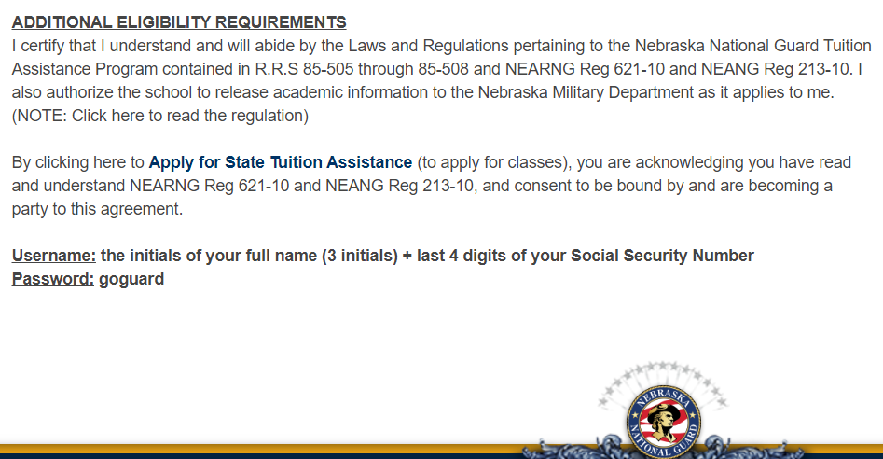
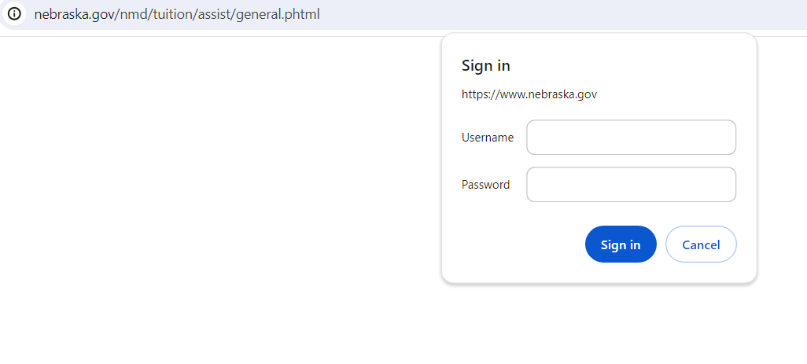
STATE TUITION ASSISTANCE APPLICATION
https://ne.ng.mil/Resources/Education-Incentives/State-Tuition-Assistance-Information/

Slide 19
GI BILL BENEFITS
https://www.va.gov/education/
CH 1606 Montgomery Selected Reserve
  High school
  IADT complete
  6-year contract
  AGR Soldiers with a MGIB-SR initial eligibility date on or after 30 June 2008 will not have their MGIB-SR eligibility suspended and remain eligible to receive MGIB-SR payments.
  Did you apply for your benefits on VA.gov?
The amounts listed here are for a full month of enrollment. We’ll pay you a percentage of the full month’s rate based on the number of days that you’re enrolled in the month. We call this a prorated payment. For example, if your school starts on the 20th, you will get a payment for 10 days of enrollment that month. Your payment would be 1/3 of the monthly rate.
We’ll pay you up to the rate listed here based on how many courses you’re taking:
Full-time enrollment: $481.00 for each full month
3/4-time enrollment: $349.00 for each full month
1/2-time enrollment: $233.00 for each full month
Less than 1/2-time enrollment: $116.50 for each full month
19
CUI

Slide 20
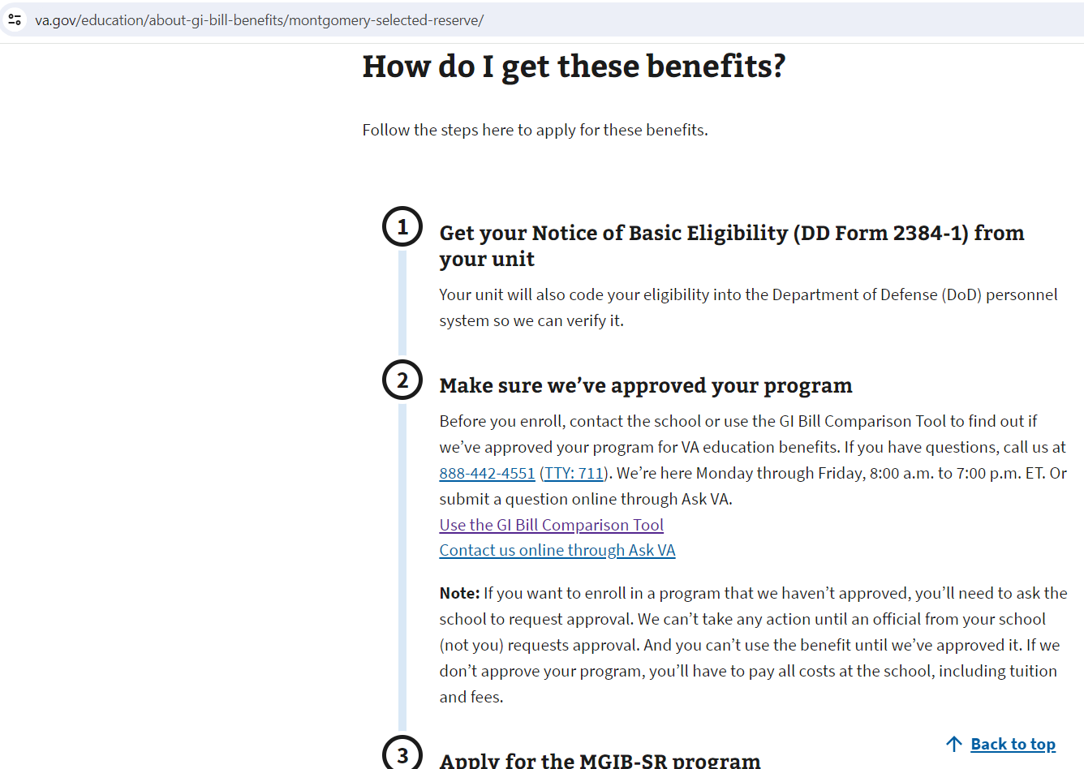
CH 1606
GI BILL Application
https://www.va.gov/education/about-gi-bill-benefits/montgomery-selected-reserve/

Slide 21
APT TESTING: AFCT & SIFT
What Do I Get?
  Armed Forces Classification Test (AFCT)
    Take this test to raise GT/Line Scores to change your MOS or qualify for Officer Candidate School
  Defense Language Aptitude Battery (DLAB), Defense Language Proficiency Test (DLPT), and Oral Proficiency Interview (OPI)
    Take these tests to qualify for Foreign Language Billets and Proficiency Bonuses
  Selection Instrument for Flight Training (SIFT)
    Take this test to qualify for Aviation School
21
CUI

Slide 22
ARMY PERSONNEL TESTING RESOURCES
AFCT prep materials
  *Online Academic Skills Course (OASC)
    OASC focuses on preparing you with the academic skills needed to do well on the ASVAB, also known as the AFCT for those already in the military. The skills you’ll learn are also applicable to many other standardized exams. https://dantes.petersons.com/
  *Basic Skills Education Program (BSEP)
    Provides on-duty academic instruction to support Soldier learning, self-development and career progression. BSEP instruction assists in the development of reading and math skills. Offered at all active Army Installation and some ARNG States.
  DoD MWR Library
    Free library resources to service members and their families. You can access different digital libraries by logging into MWR Library and clicking on a selected library like EBSCO Learning Express. EBSCO provides practice test on ASVAB, AFCT, SIFT, CLEP, DSST and much more. http://mwrlibrary.armybiznet.com/
SIFT prep materials
  https://www.petersons.com/testprep/product/sift-practice-test-plus/
  https://www.prepterminal.com/courses/sift-practice-test-and-study-guide
  https://www.ugoprep.com/free-sift-practice-tests/
22
CUI

Slide 23
DANTES CLEP EXAMS
Step 1: Visit the College Board web site at: https://clep.collegeboard.org
Step 2: Contact your state education office and/or school to ask questions, determine your school policy on credit-by-exam acceptance, and get additional help with finding a testing location and registering to take an exam
Step 3: Create your college board account and register for a test at: www.account/collegeboard.org/login/signUp
When registering, designate yourself as DANTES-funded and answer questions about your military Service in order to receive DANTES funding
During the registration process, indicate DANTES-funding eligible
23
CUI

Slide 24
DANTES CLEP EXAMS (continued)
Step 4: Prepare for your test. View sample questions and get study materials from the CollegeBoard website.
Step 5: Take the test. Present the printed "ticket", your authorized military I.D. (e.g. CAC) and a second form of I.D. to the Test Administrator
Step 6: View your results. All CLEP exam registrations come with a free score report sent to your college of choice, which must be input when you register.
For more information go to the DANTES web site at: https://www.dantes.doded.mil/EducationPrograms/get-credit/creditexam.html
24
CUI

Slide 25
HELPFUL LINKS
Federal Tuition Assistance: http://www.goarmyed.com
GI Bill Program: http://www.gibill.va.gov
DANTES: http://www.dantes.doded.mil/index.html
CLEP Exams: http://clep.collegeboard.org
DSST Exams: http://getcollegecredit.com/
ACT: http://www.act.org
SAT: https://collegereadiness.collegeboard.org/sat
GMAT: http://www.mba.com/us
GRE: https://www.ets.org/gre
GED: https://ged.com/
Praxis: http://www.ets.org/praxis
Credentialing Opportunities Online: https://www.cool.army.mil
TEB Request: https://www.dmdc.osd.mil/milconnect
eBenefits: https://www.ebenefits.va.gov
Joint Service Transcripts: https://jst.doded.mil
eArmyLearning: https://www.us.army.mil (Click on Self Service then My Education for Army eLearning)
25
CUI

Slide 26

https://armyignited.army.mil/student

Slide 27
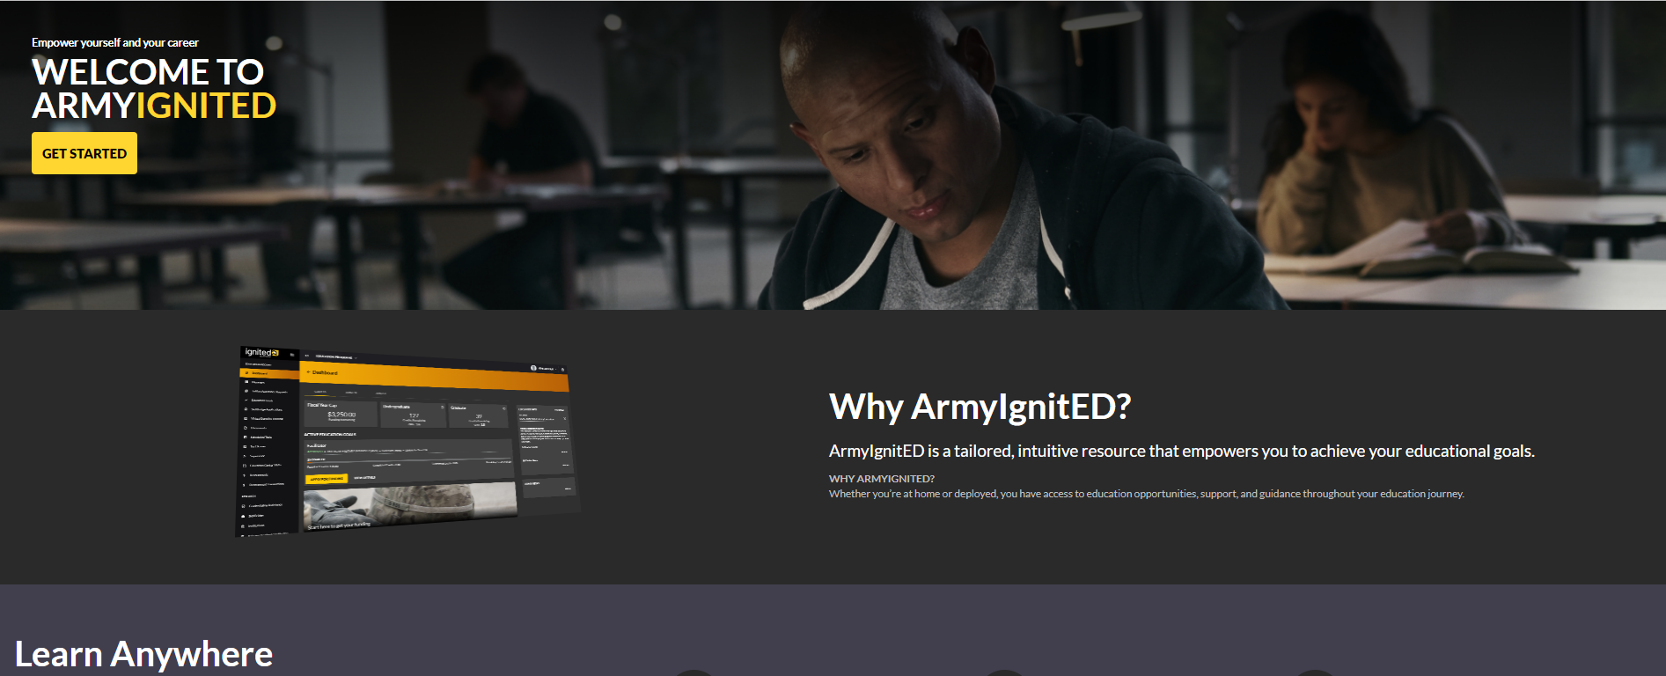
Creating an ArmyIgnitED Account
CUI
Select “Get Started”
ArmyIgnitED Website: https://www.armyignited.army.mil/
27
CUI

Slide 28

Funding Method
28
CUI

Slide 29

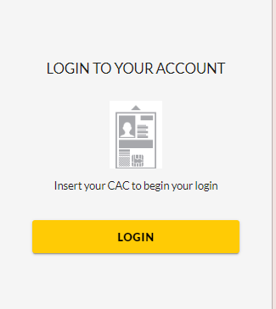
Logging Into ArmyIgnitED
If your record is not found, contact the Helpdesk for assistance.
Phone: (276) 231-0938 or email: army@bamtech.net
29
CUI

Slide 30
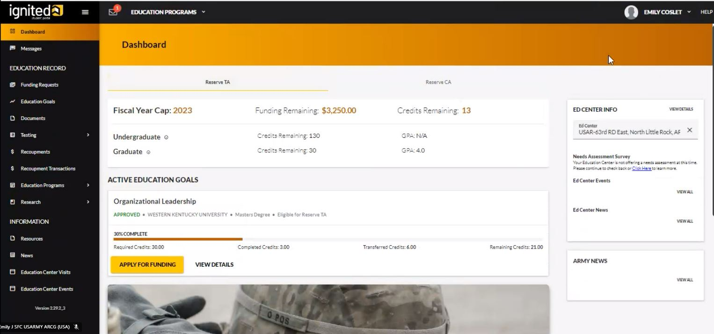
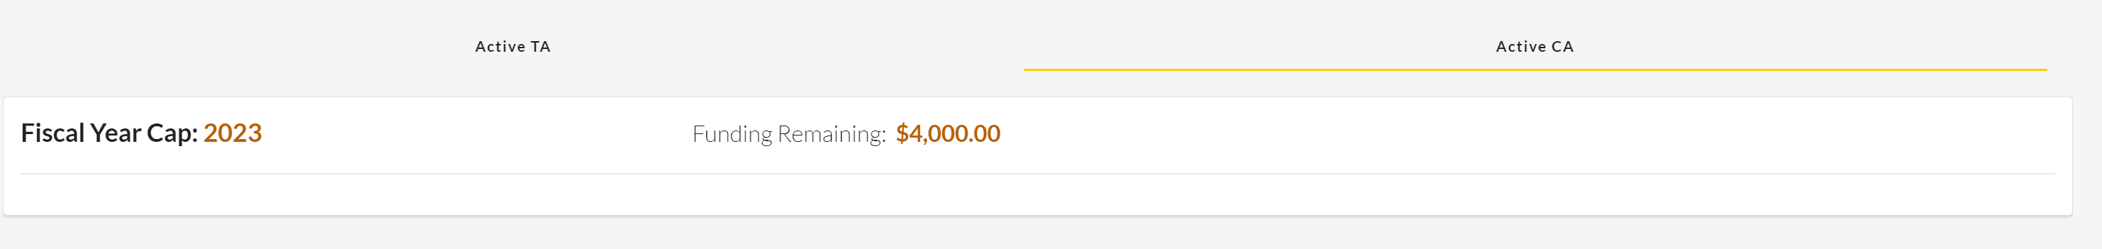
Navigating ArmyIgnitED
Student Dashboard
Fiscal Year Limits
Active TA
Active CA
Ed Center Info.
Site Navigation
Lifetime Limits
GPA
CA Limit
30
CUI

Slide 31
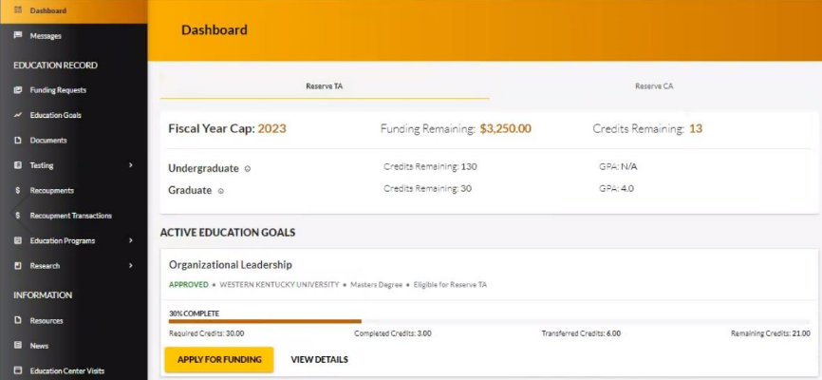
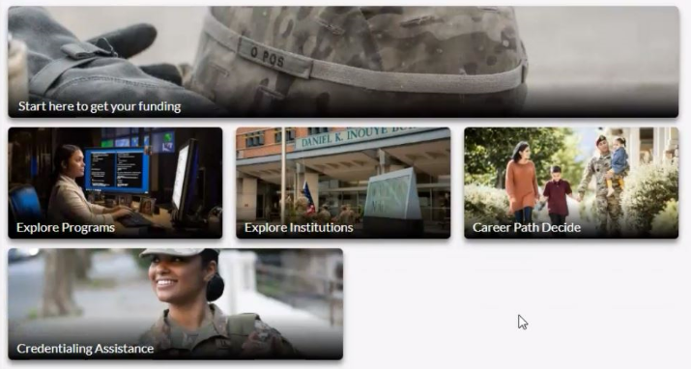
Navigating ArmyIgnitED
Student Dashboard
Active Ed Goal
At the bottom of the dashboard, are links to get started to explore funding, programs, institutions, and careers
31
CUI

Slide 32
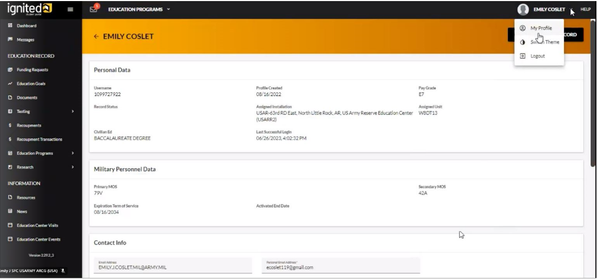
Navigating ArmyIgnitED (continued 1)
Reviewing Profile Page
tomcruise000
To access your Profile Page, on the top right of the page, click on your name and
click on “My Profile”. This has your user information, contact information, and mailing address.
Student and Military Information migrate into ArmyIgnitED from IPPS-A
To Update Civilian Ed Level, contact Unit Personnel / S1 Office
Civilian Education Level must be current to maintain TA/CA eligibility
32
CUI

Slide 33
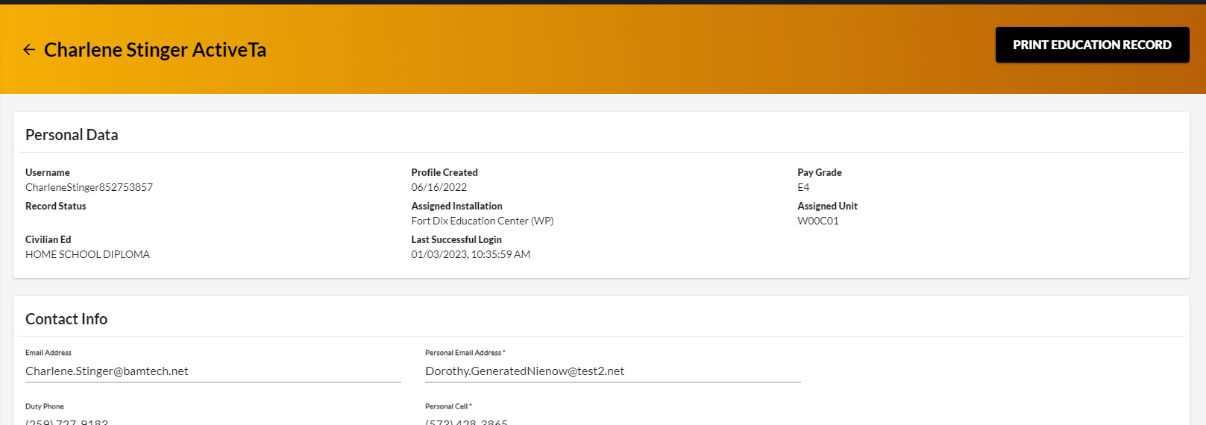
Navigating ArmyIgnitED (continued 2)
Reviewing Profile Page
Provides a copy of your Education Record
TOM CRUISE
tomcruise000
Tomcruise000.mil@army.mil
Verify that contact information is correct. A personal email address and cell phone number are required.
33
CUI

Slide 34
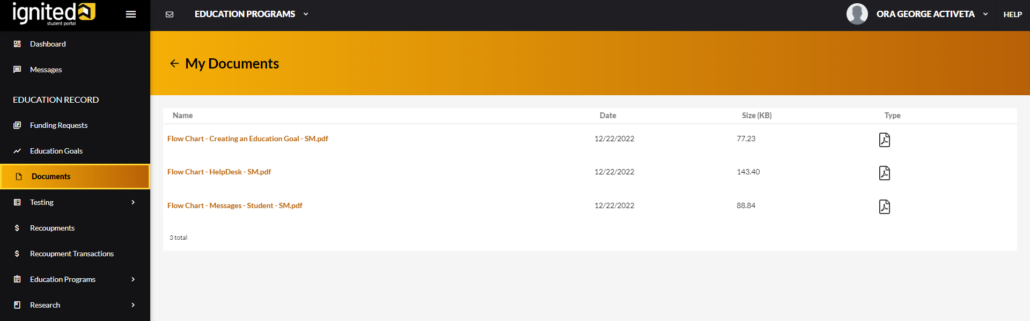
Navigating ArmyIgnitED (continued)
Student Documents
Click on “Documents” on the left of your Dashboard to access and review uploaded documents
*Important! ArmyIgnitED does not allow Soldiers to upload documents to their account, you must send any documents through the ArmyIgnitED messaging system, and your education center staff will upload them for you.
34
CUI

Slide 35
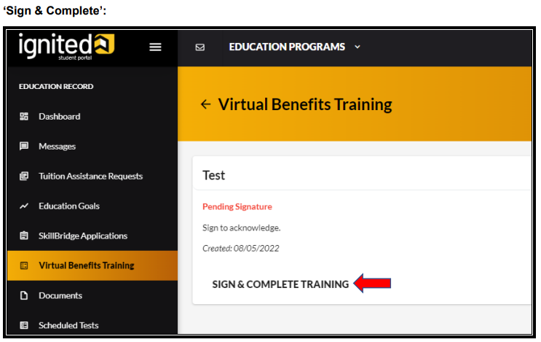
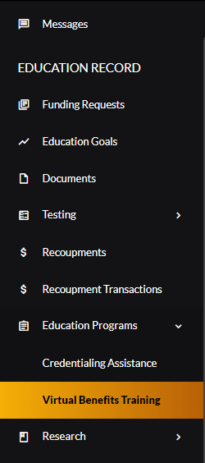
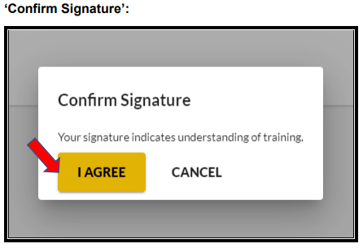
Virtual Benefits Training
Before requesting Tuition Assistance, you must sign and complete the Virtual Benefits Training
Important! You MUST complete your Virtual Benefits Training to request TA
35
CUI

Slide 36
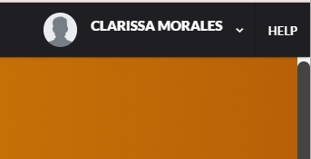
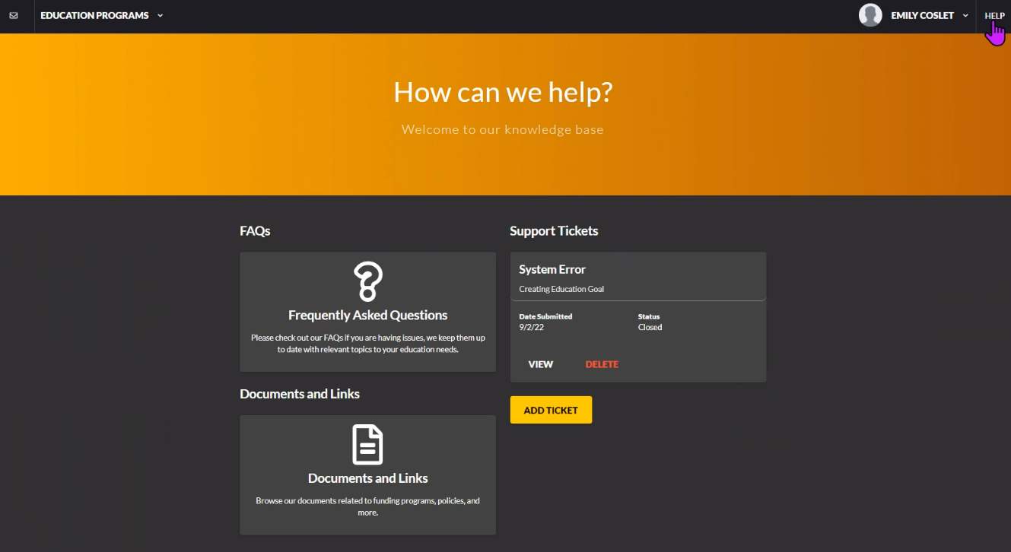
How to Get Help
Click on “Help” to find FAQs, Support (Help Desk) Tickets, and Documents/Links
EMILY COSLET
36
CUI

Slide 37
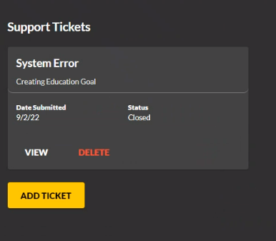
Submitting a Support Ticket
On the Help Home Page, under “Support Tickets” will be the status of any ticket submitted
Click on “Add Ticket” button to begin submitting a help ticket. It will take you to a page where you can submit tickets under specific categories.
37
CUI

Slide 38
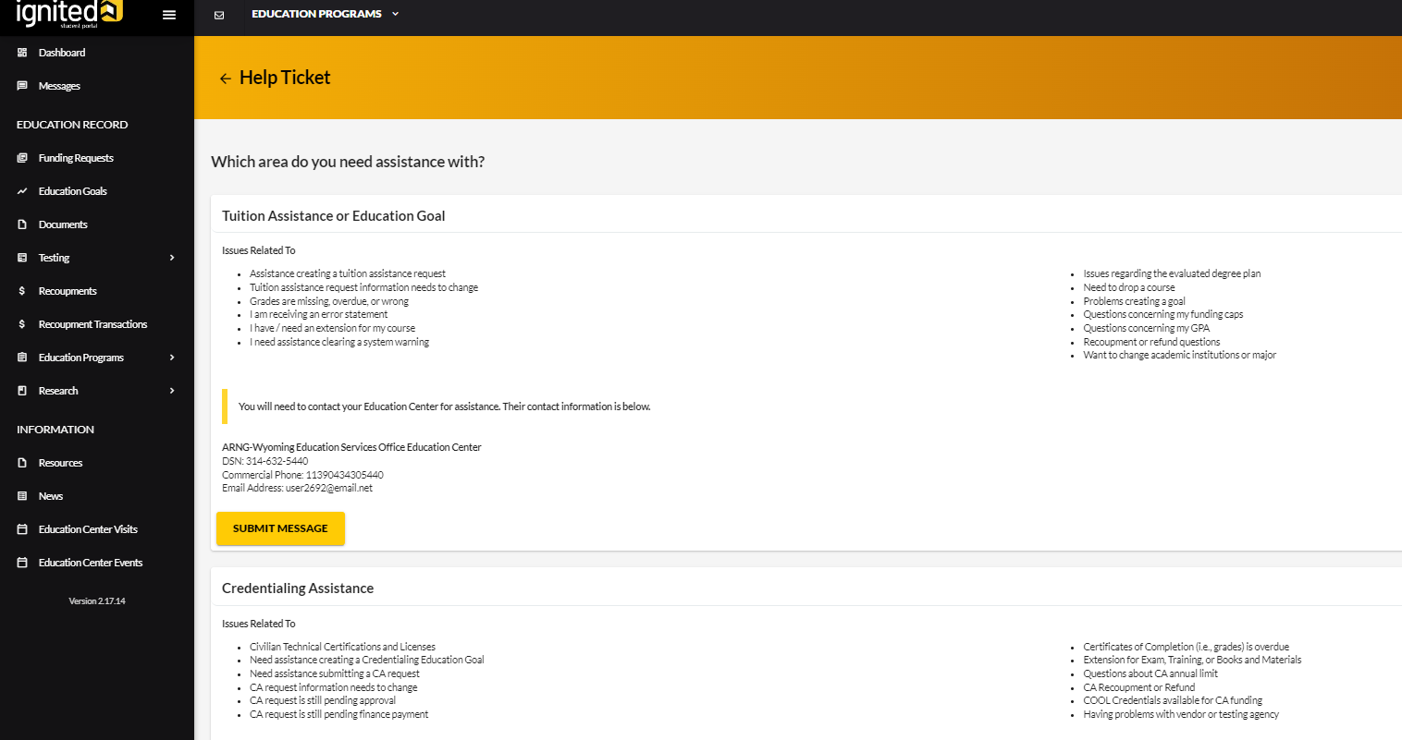
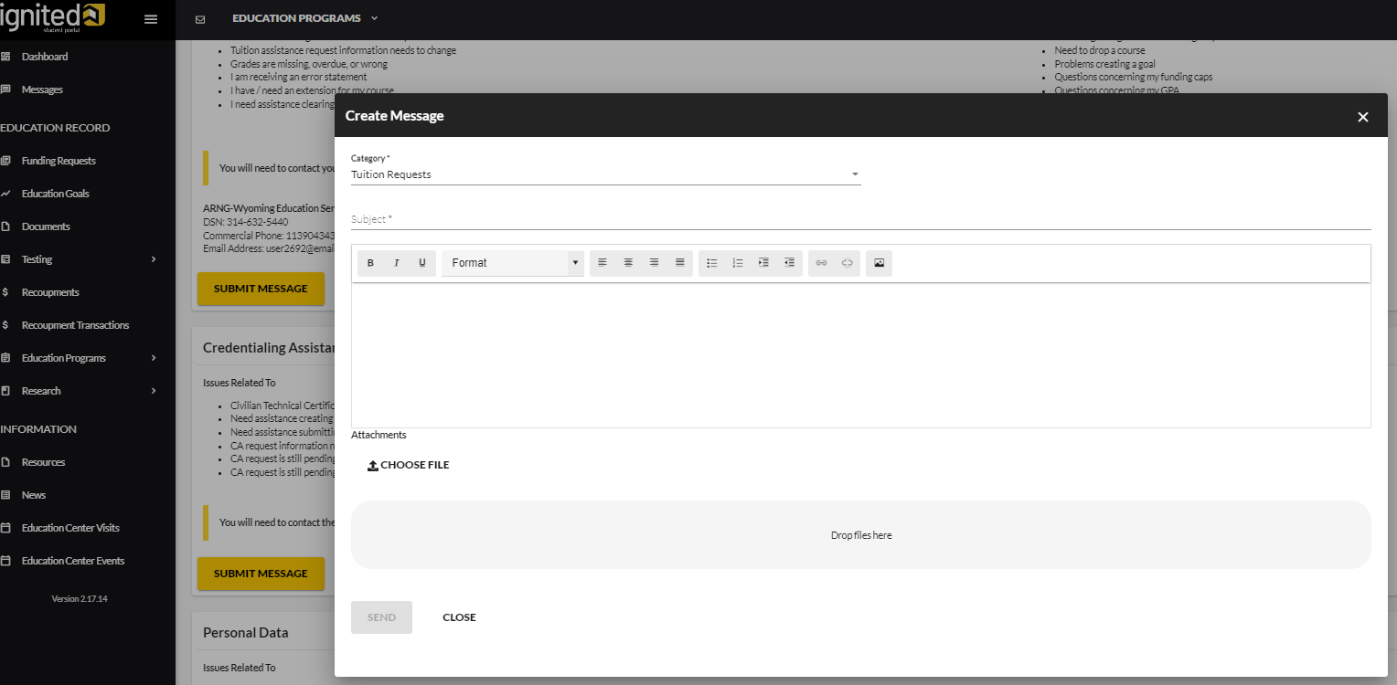
Submitting a Support Ticket (continued)
38
CUI

Slide 39
Tips for Submitting a TA Request (TAR)
View the tutorials in ArmyIgnitED or ask your assigned Education Services Specialist (ESS) or Education Services Officer (ESO)
Submit one course at a time (that way if there is an error, not all TA requests will be deleted)
Do not click on ‘VA Top Up’ if using MGIB-SR/Ch 1606
Once your TARs are approved, print off the authorization forms (pdf) to provide to your AI as proof of payment
Log back into ArmyIgnitED and double-check that your course information is correct, and your courses have been approved PRIOR to the start date
39
CUI

Slide 40
Next Steps
Go to ArmyIgnitED, click on ‘Messages’, create a new message, copy the statement listed below, and send it to your assigned state Education Office and/or Education Counselor:
  “I reviewed the ArmyIgnitED 101 slide presentation and completed my required training on [day/month/year]”
Contact your assigned Education Services Specialist (ESS) and/or Education Services Officer (ESO): www.nationalguard.com/select-your-state
  Discuss your education pathway, goal, and available state and federal education benefits
Submit your TA/CA request and start your education journey!
40
CUI

Slide 41
Points Of Contact Nebraska Education Services Office
Education NCOIC: SFC Joshua Sladky, 402-309-7344
Incentives/Bonuses: Mr. Jovon Winnell, 402-309-8153
ESS Nebraska: SGT Marco Sapien, 402-309-7336
Education and Incentives Email: ng.ne.nearng.list.g1-education-and-incentives@army.mil
Army Ignited ESS NGB: Mr. Joshua Whiting, (515) 252-4422
Army Ignited SESS NGB: Ms. Dominique Gill, 361-596-3737
State Tuition: Mrs. Heather McConnon, 402-309-8124
Visit us on MS Teams
  ARNG Public-Education Services (Team code: 1oeyukp)
  https://dod.teams.microsoft.us/l/team/19%3Adod%3Aef1fa3b161ac48f393ae4de579ea9f8a%40thread.skype/conversations?groupId=0b083e5f-e8d4-406f-9b54-ef4463d35b9d&tenantId=fae6d70f-954b-4811-92b6-0530d6f84c43

Slide 42






Visit us on Social Media!
https://www.facebook.com/arngeducation
https://www.instagram.com/arngeducation
https://www.twitter.com/arngeducation
https://www.linkedin.com/company/arngeducation
https://www.youtube.com/@ARNGEducation

